Slide 1
Tutorial 1 Learning Topology Optimization Through Examples and Case Studies
August 18, 2019

Slide 2
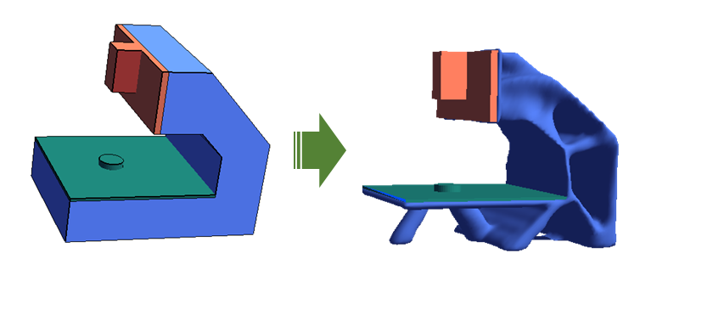
Multi-body

Slide 3
Motivation
https://grabcad.com/library/contact-stress-analysis-in-a-spur-gear-assembly-1
Interface Types:
Bonded
Sliding
Frictionless
W/ Friction
To be added…

Slide 4
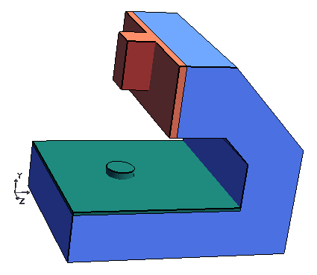
CNC Frame Design
3 Bodies with different materials
Aluminum Al1060
Do not Optimize!
Optimize!
Cast Iron Gr25
Alloy Steel
Do not Optimize!

Slide 5
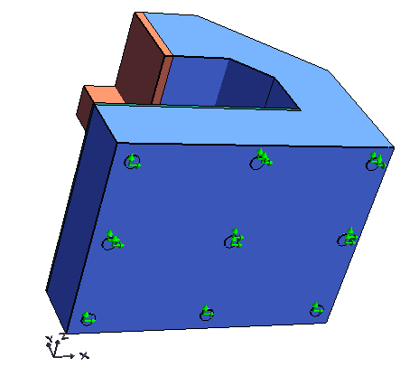
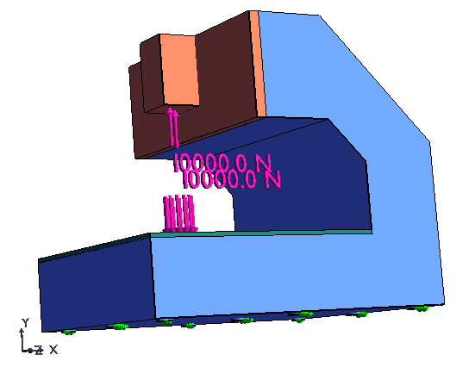
CNC Frame Loads

Slide 6
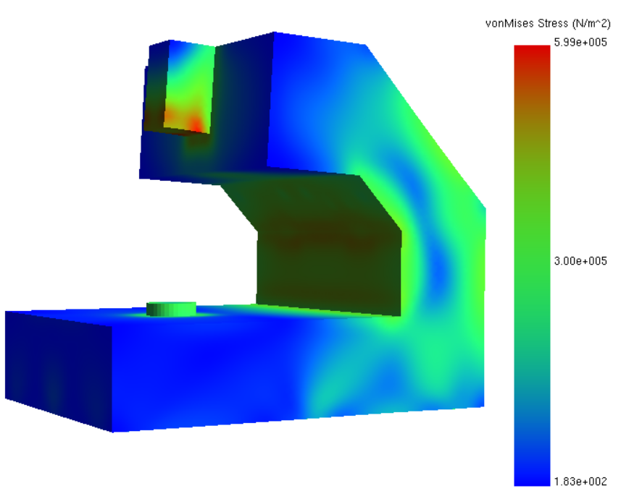
CNC Frame FEA

Slide 7
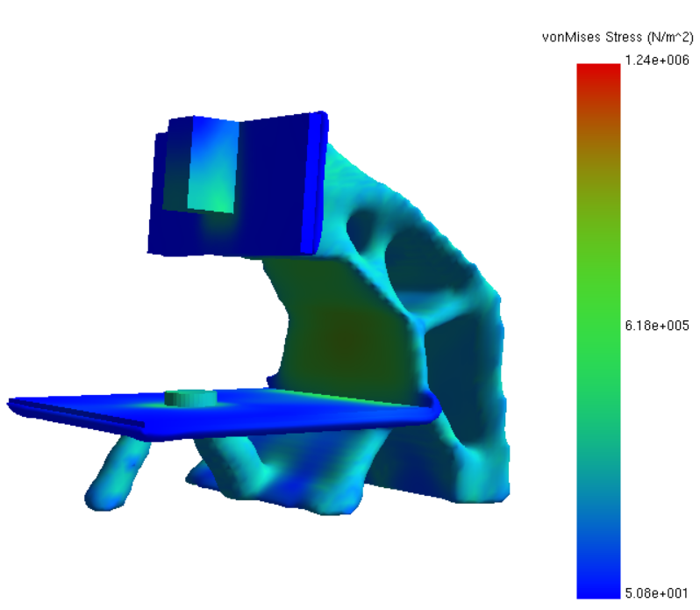
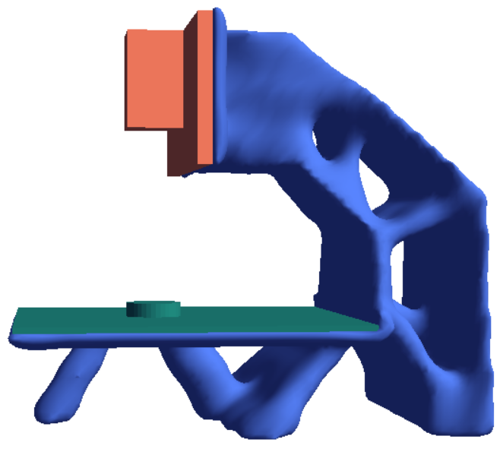
CNC Frame Optimized

